Slide 1
 | Queen’s University Alternative Assets Fund 2018 Beijing Recruitment Presentation

Slide 2

 | Overview
What is the QUAAF? | 4
What does the QUAAF do? | 4
What are the benefits? | 5
Team Structure | 7
Description of Positions | 8
Timeline for applications and interviews | 14
Q & A | 15

Slide 3
 | Organization Overview

Slide 4
 | What is QUAAF?
What is it all about?
An educational program of the Smith School of Business
What is the purpose?
Helping MBA and Master of Finance students to acquire investment knowledge and hands-on experience through practicing alternative asset allocation strategies in real money.
Main responsibilities including but not limited to:
Conducing due diligence, tracking assigned funds every month, making recommendations on investments, writing research reports and holding regular meetings with the MBA and MFIN-Toronto teams in Kingston and Toronto.

Slide 5
 | What does QUAAF do?
This year we are going to…
Play more important roles in investment decision-making process.
Complete research projects.
Meet industry leaders.
Network with local financial experts.
Attend financial forums in Beijing.
Market ourselves.
And more…..

Slide 6
 | Why join QUAAF?
Benefits QUAAF can bring to you:
Hands-on experience running an investment fund
More industry-related research
Networking to more financial experts
Career background enhancement
Great opportunities to experience different events
And more….

Slide 7
 | Team Structure and Positions

Slide 8
 | Beijing Organization Structure
Position | Open Vacancies
Portfolio Analysts | 4+
Risk Analysts | 1+
Special Projects Analysts | 2+
Marketing Specialists | 4+
TOTAL | 11
Director of Operations
Director of Business Development (Internal Affairs)
Director of Business Development (External Affairs)
Portfolio Analysts
Risk Analysts
Marketing Managers
Special Projects Analysts (can report to anyone including Dir. of Ops.)
Marketing Specialists

Slide 9
 | Internal Affairs – Portfolio Analysts (4+)
Portfolio Analyst - Description
What can I expect to gain?
A Portfolio Analyst will be assigned a certain number of investment funds. The analyst will be responsible for tracking and monitoring the performance of these funds each month.
Practical experience performing investment research and evaluating investment managers
Publish research as an example of your work to prospective employers
Use the QUAAF as a tool to build a relationship with asset managers and professional bodies

Slide 10
 | Internal Affairs – Risk Analysts (1+)
Risk Analyst - Description
What can I expect to gain?
A Risk Analyst will be assigned a certain number of investment funds. The analyst will be responsible for monitoring the risk levels of these assigned funds. each month.
Practical experience performing investment research and evaluating investment managers
Publish research as an example of your work to prospective employers
Use the QUAAF as a tool to build a relationship with asset managers and professional bodies

Slide 11
 | External Affairs – Special Projects Analysts (2+)
Special Projects Analyst - Description
What can I expect to gain?
QUAAF may start Special Projects throughout the course of its operating year. A Special Projects Analyst will be required to complete tasks assigned by a Special Projects Manager.
Practical experience performing industry research
Work on exciting projects for external clients
Build your resume with the research perform

Slide 12
 | External Affairs – Marketing Specialists (4+)
Marketing Specialist - Description
What can I expect to gain?
Holding events such as educational seminars.
Networking opportunities!
Learn how to build and develop strategic relationships
Actively seeking potential clients or cooperators to participate the education seminar as guest speakers
Selling research papers to companies who need our service
Practice “soft skills”

Slide 13
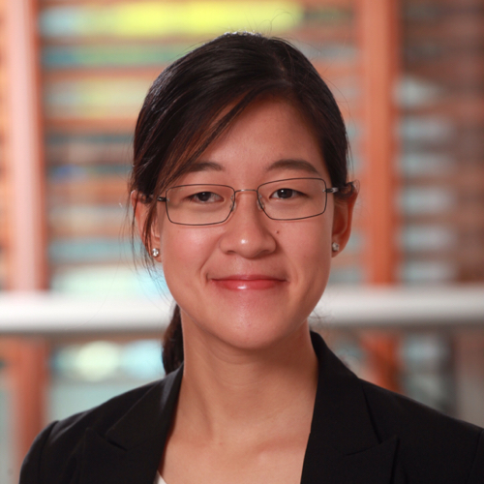
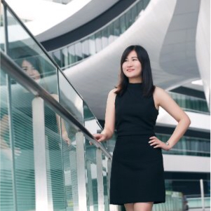
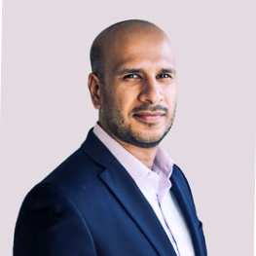
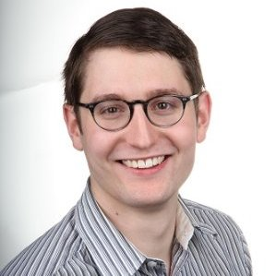
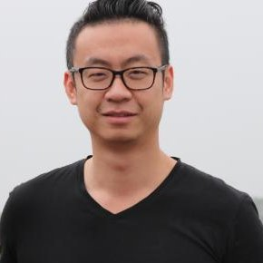
 | Why should I participate in QUAAF?

Slide 14
 | Timeline for applications and interviews
September 12
Last day to submit applications (resume and statement of interest)
September 13->20
Interviews
September 25
Announcement of 2018 QUAAF Beijing team

Slide 15
 | Contact Information and Questions
Please send us your resume and statement to the following email address: alexander.mcginn@queensu.ca

